Slide 1
DIGITAL BOARD MARKER(Storage Efficient System for Class Lectures) (Final Year Project)
Advisor:
Mr. Samyan Qayyum Wahla
Group Members:
Muhammad Haris Khan [2016-CS-105]
Hamza Farooq [2016-CS-122]
Ayesha Atif [2016-CS-152]
Komal Shehzadi [2016-CS-178]

Slide 2
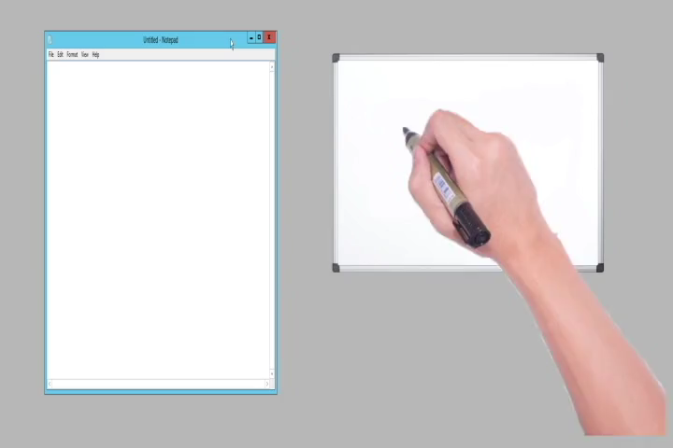
Demo Video

Slide 3
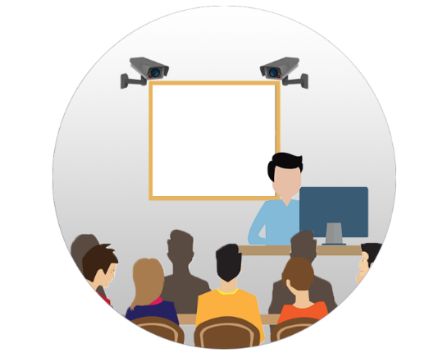

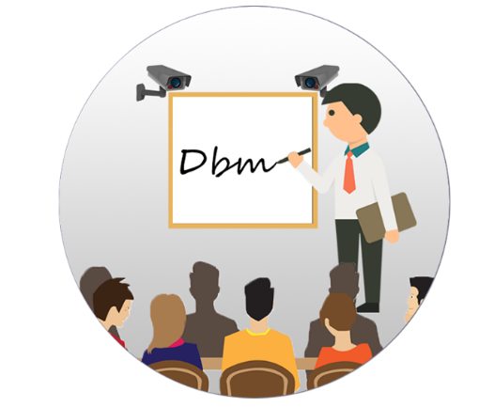
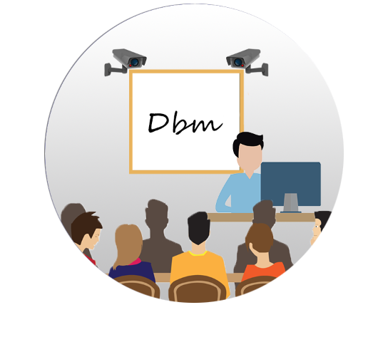
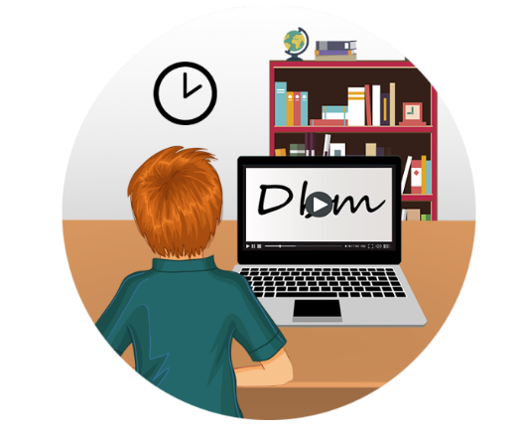
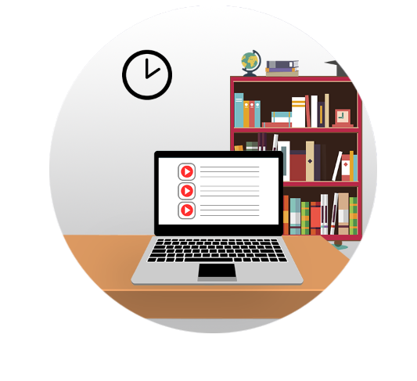
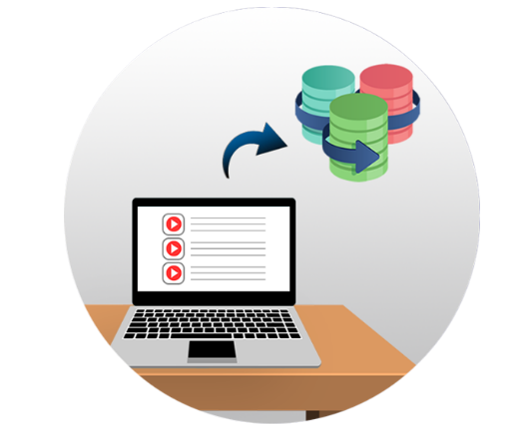

Open the controller app and press the ‘Start’ Button.
Start the lecture as lecture recording is started.
At the end of lecture, press ‘END’ button on controller application.
General Flow
Play and enjoy the lecture.
Want to listen the lecture!
Open web application to view lecture list.
Lecture saved and uploaded on web application.

Slide 4

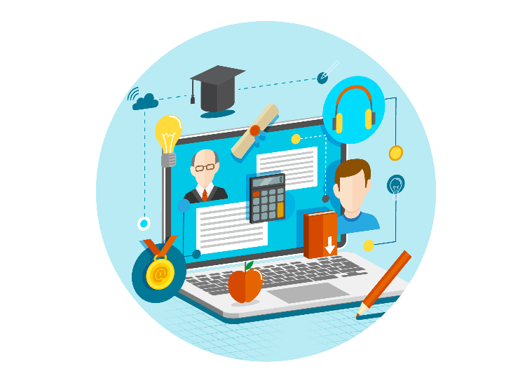
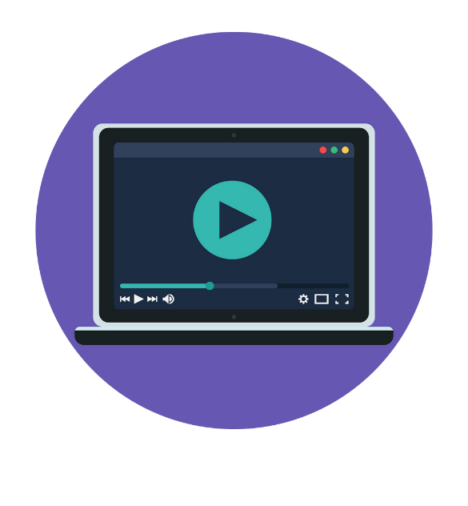

PROJECT OVERVIEW
Storage Efficient System
Complete LMS
Bandwidth Efficient System
Offline Player

Slide 5

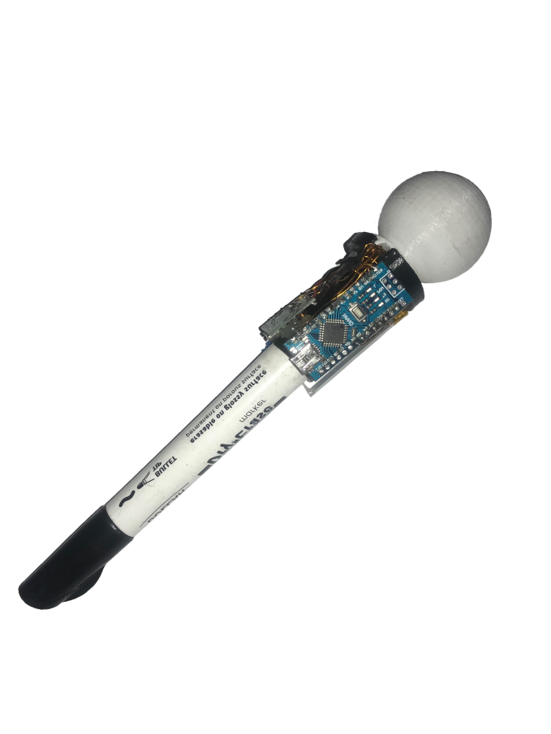


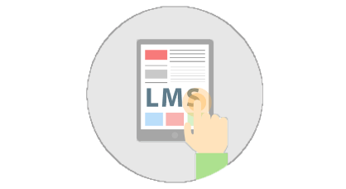

MOTIVATION
Minimizing Resources
Difficulty in writing Notes as well as listening and understanding
Less bandwidth usage
Less storage
Play without internet

Slide 6
PROBLEM STATEMENT
“To make a storage and bandwidth efficient system with a lecture player and learning management system for the students and the educational institutes.”

Slide 7
SCOPE
The proposed system will:
Record lecture with two stereo vision cameras frame rate 60 FPS.
Animate lecture on web application and also on the offline player.
Serve as an innovative LMS.
Record lecture using two camera stereo vision.
Record voice and board marker position data using custom developed wireless modules.
Use a whiteboard of dimension 4x3 ft.
Play lectures on a dedicated player (json to video player).
Store json data in encrypted format which will be later used in formation of video animation

Slide 8


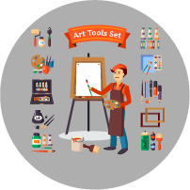

APPLICATION AREAS
Educational Institutes
DBM
Applications
Industrial Presentations
Sketch Artists
Online Tutors

Slide 9
COMPARISON WITH EXISTING SYSTEMS
Initiative | Storage Space per sec | Storage Efficiency | Encrypted format | Dedicated Player | Custom Content | Brandable | Free to Access | For Profit | Class Strength
Edx | 793.6 KB | ✕ | ✕ | ✕ | ✓ | ✓ | ✓ | ✕ | 300,000
Moodle | 720 KB | ✕ | ✕ | ✕ | ✕ | ✓ | ✓ | ✓ | 10,000
Coursera | 750 KB | ✕ | ✕ | ✕ | ✓ | ✕ | ✓ | ✓ | Unlimited
Udemy | 790 KB | ✕ | ✕ | ✕ | ✓ | ✕ | ✕ | ✓ | Unlimited
Udacity | 790 KB | ✕ | ✕ | ✕ | ✓ | ✓ | ✓ | ✓ | Unlimited
DBM | 14.5 KB | ✓ | ✓ | ✓ | ✓ | ✓ | ✓ | ✓ | Unlimited

Slide 10
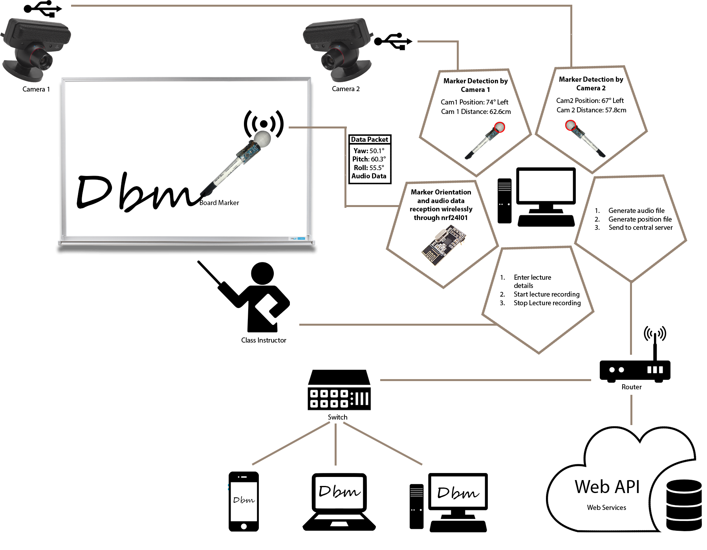
Architecture Diagram

Slide 11
Requirements/Success Scenarios
Controller Application
Teacher starts controller application.
Lecture starts recording.
Lecture ends and file stored in local pc.
Lecture file uploaded on server.
Lecture can be downloaded in offline player and can be played.

Slide 12
Requirements/Success Scenarios
Website
User register to the website.
User login to website.
User add/view/delete course depending upon designation.
User add/view/delete course content depending upon designation.
Course content include assignments, announcements, lecture notes.
User can play lecture that was recorded by teacher using controller application.

